Slide 1
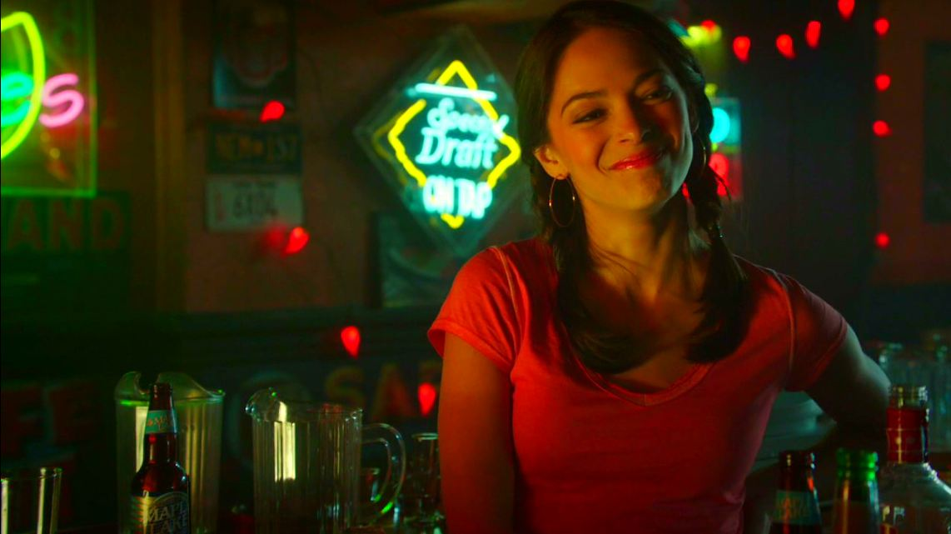
1) What university did Catherine attend?

Slide 2
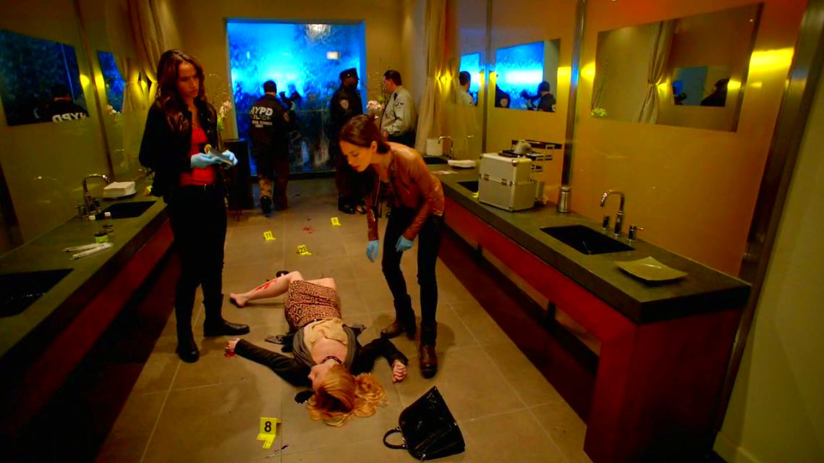
2) In which hotel was Ashley Webber found dead?

Slide 3
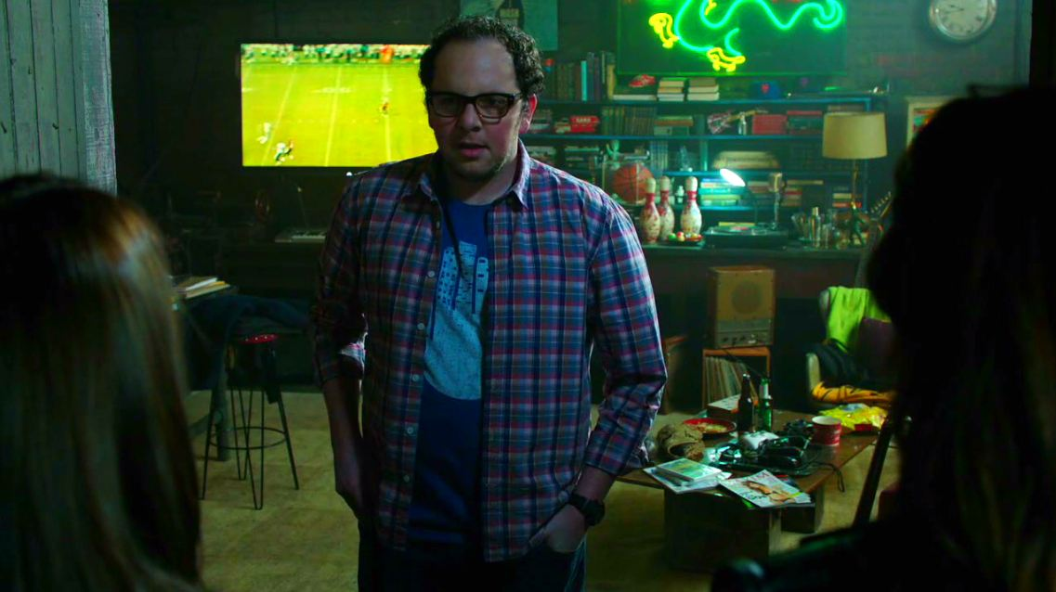
3) The first time JT met Cat & Tess what did he assume they wanted?

Slide 4
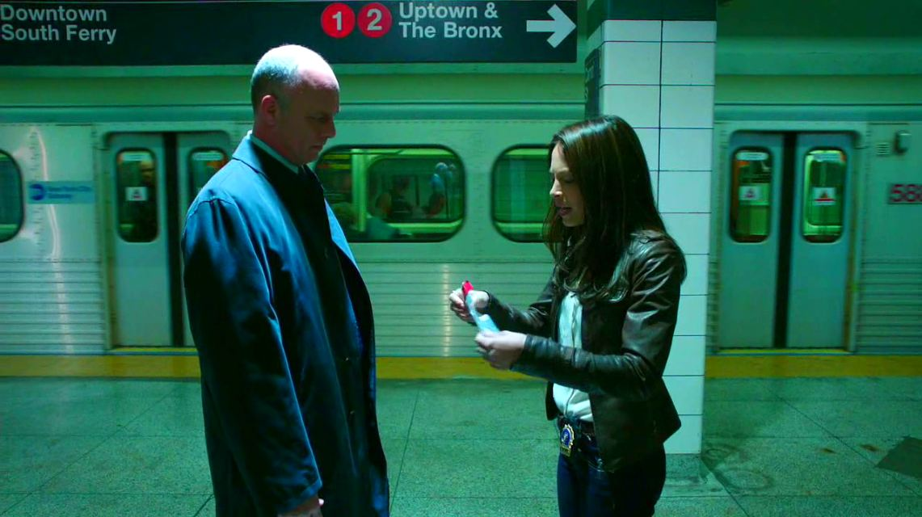
4) What was the name of the FBI agent Cat met in the subway to handover the contaminated DNA sample?

Slide 5
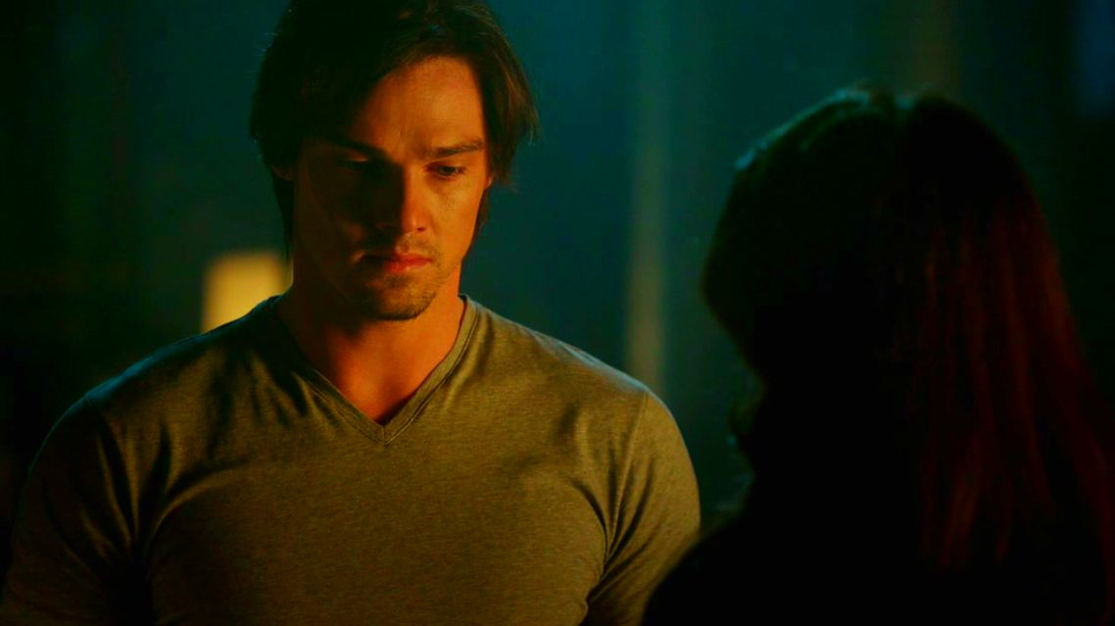
5) How many cases did Cat tell Vincent she had found of him helping people around the city?

Slide 6
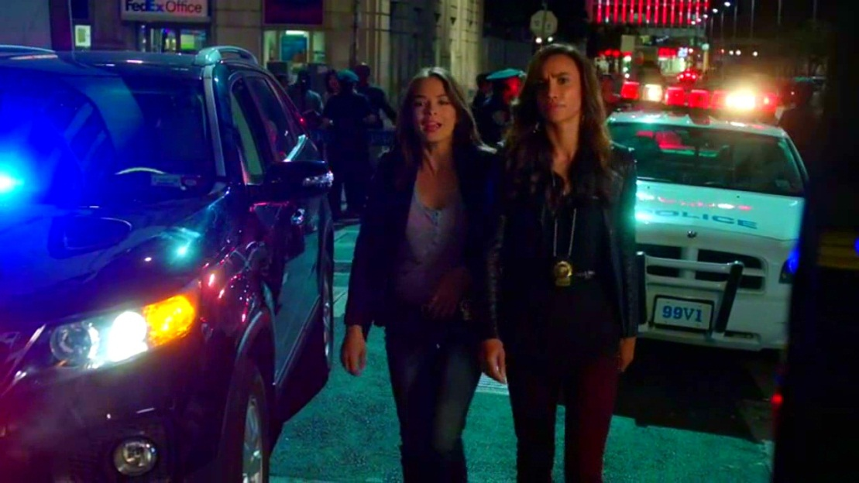
6) How many brothers does Tess have?

Slide 7
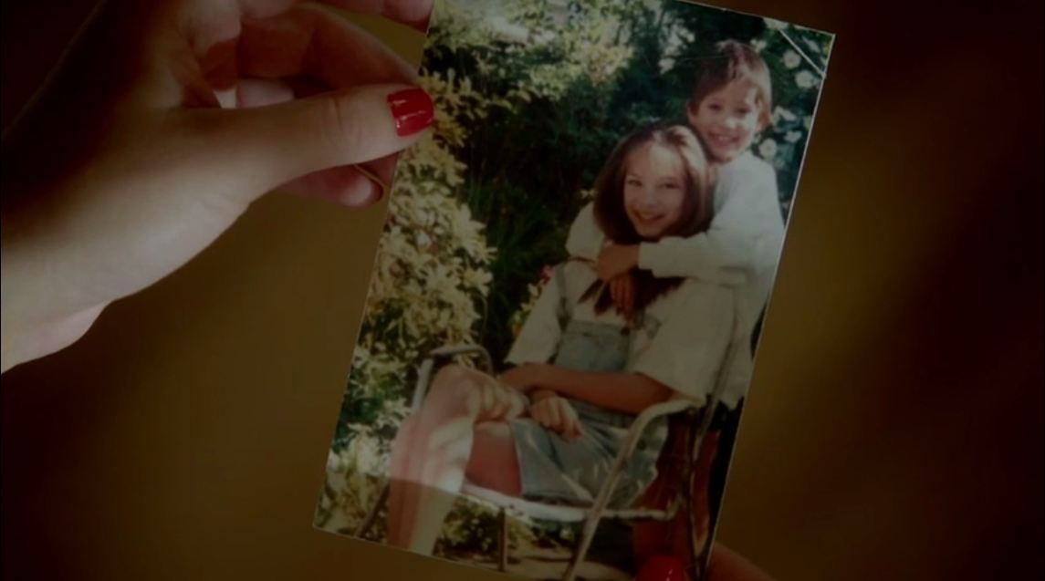
7) Where is this picture of Cat & Heather taken?

Slide 8
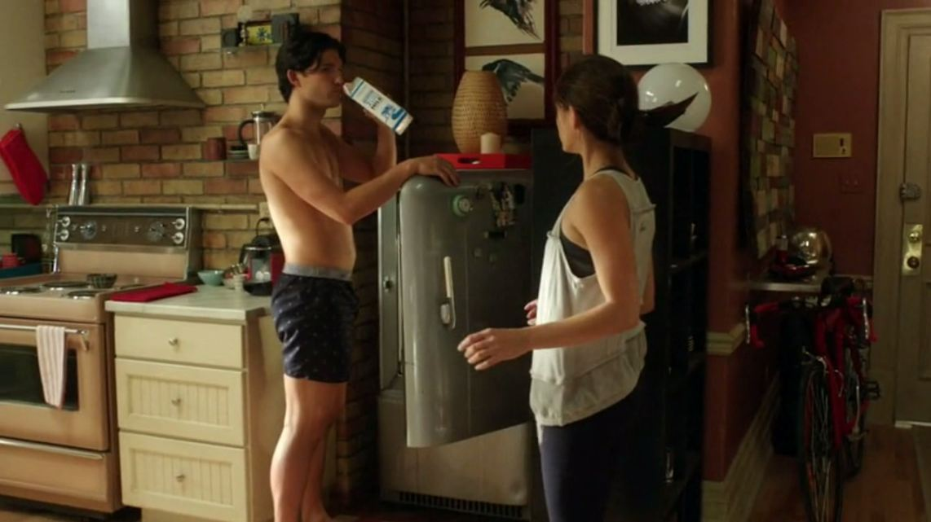
8) What is the name of this man drinking from Cat's fridge?

Slide 9
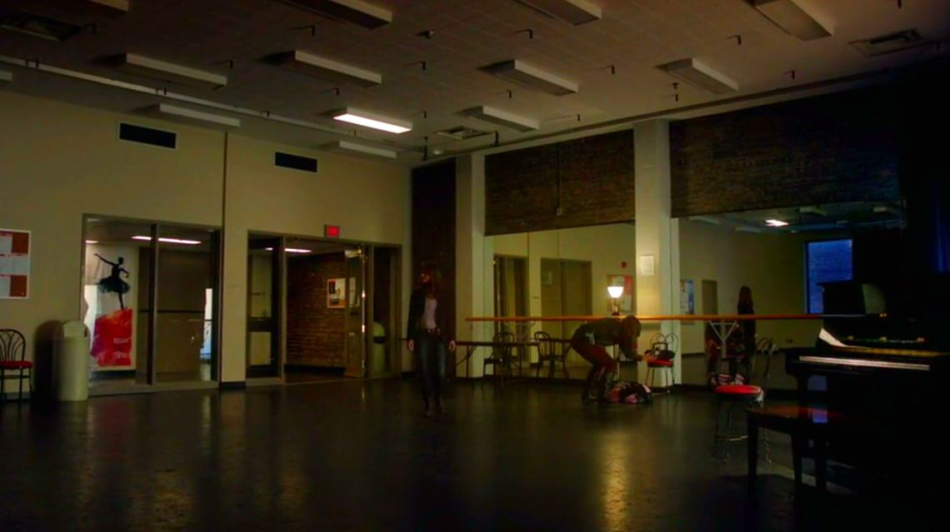
9) What ballet company did Gemma Parker work for?

Slide 10
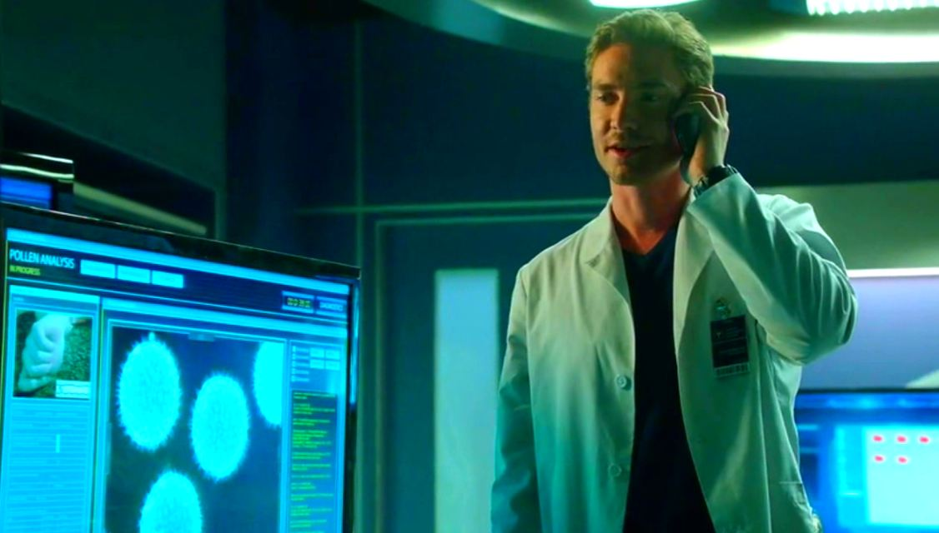
10) What was the powder they found on Gemma's hands?

Slide 11
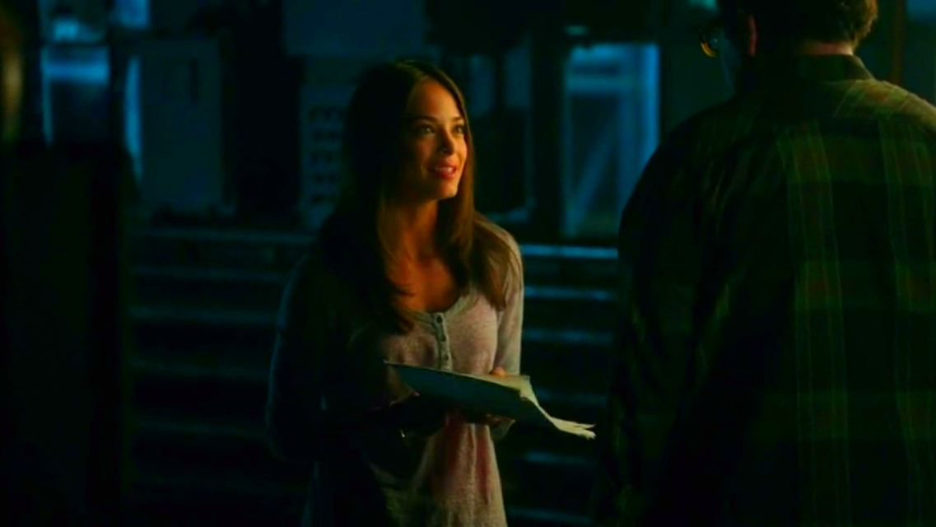
11) What were Cat's moms papers about that she left for JT to pass to Vincent to read?

Slide 12
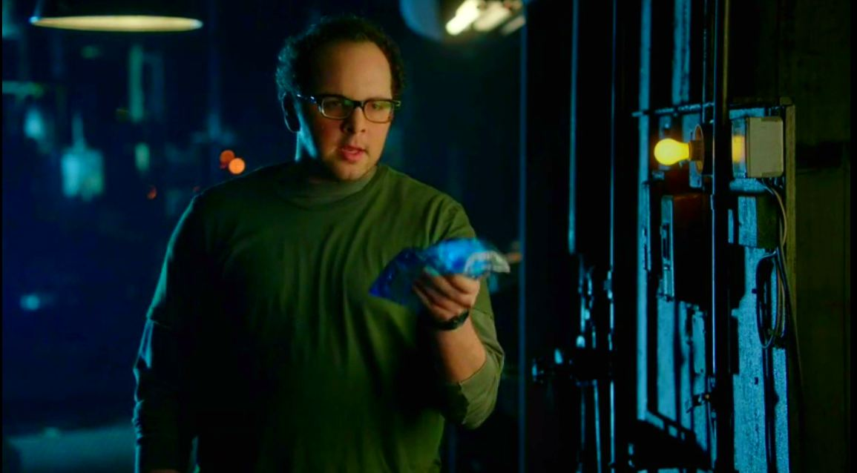
12) How much did JT say that Cat owed him for a Lumbar Pack?

Slide 13
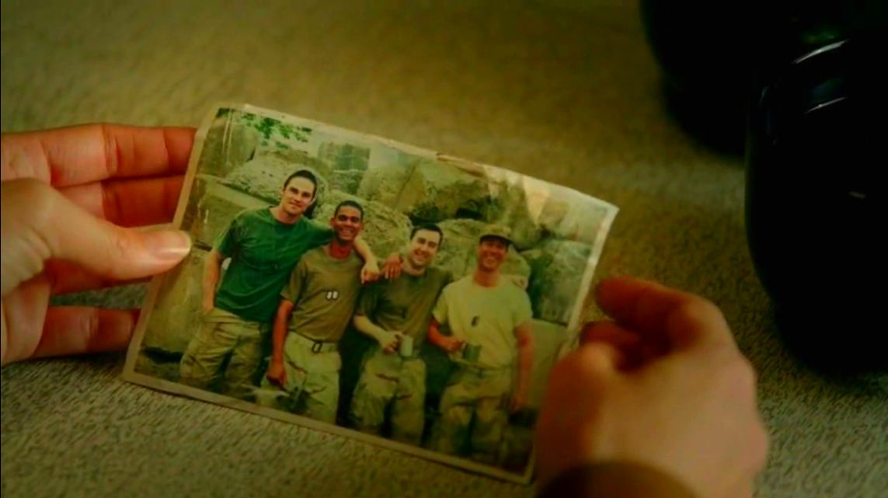
13) What did Vincent say was the nickname for his army buddy Ray?

Slide 14
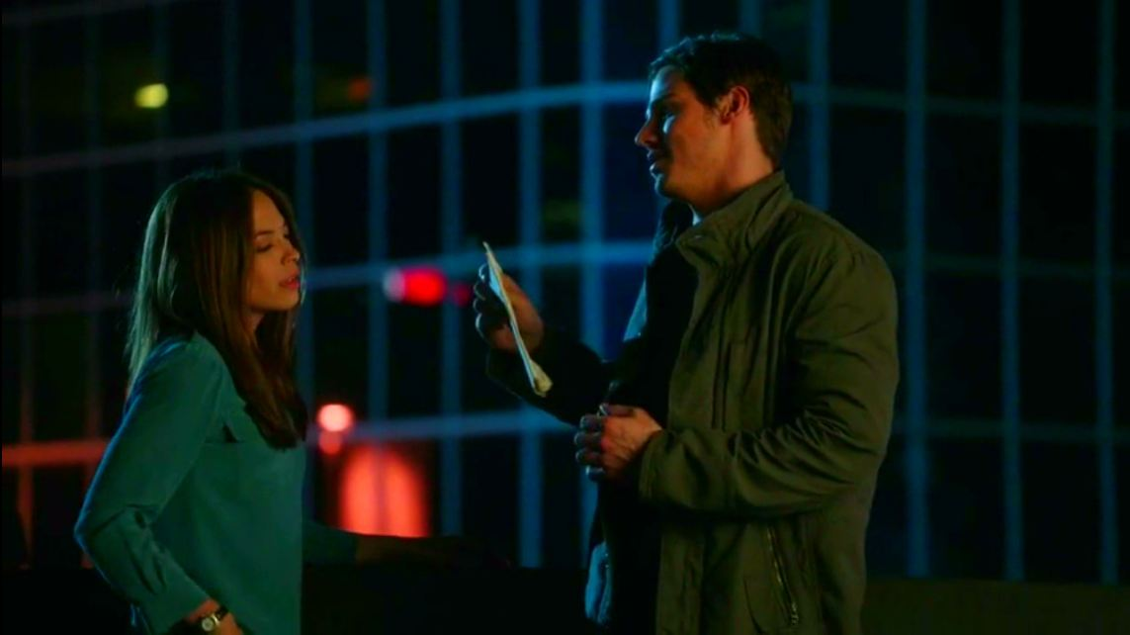
14) What did Vincent jokingly call the letter that Cat had sent him?

Slide 15
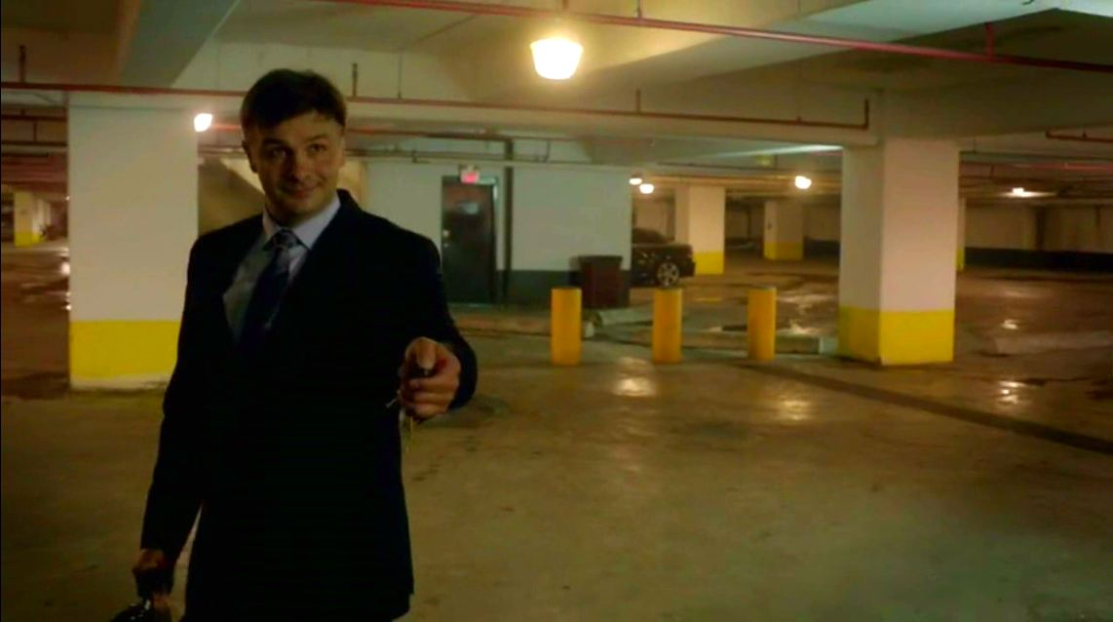
15) What was the name of the judge that was killed by a car in a hit & run?

Slide 16
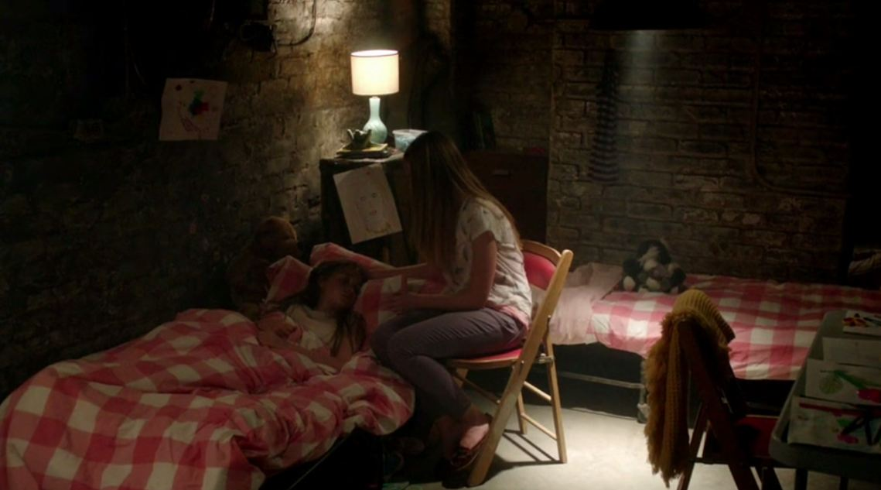
16) What are the names of Iris Sodkovic's younger sisters?

Slide 17
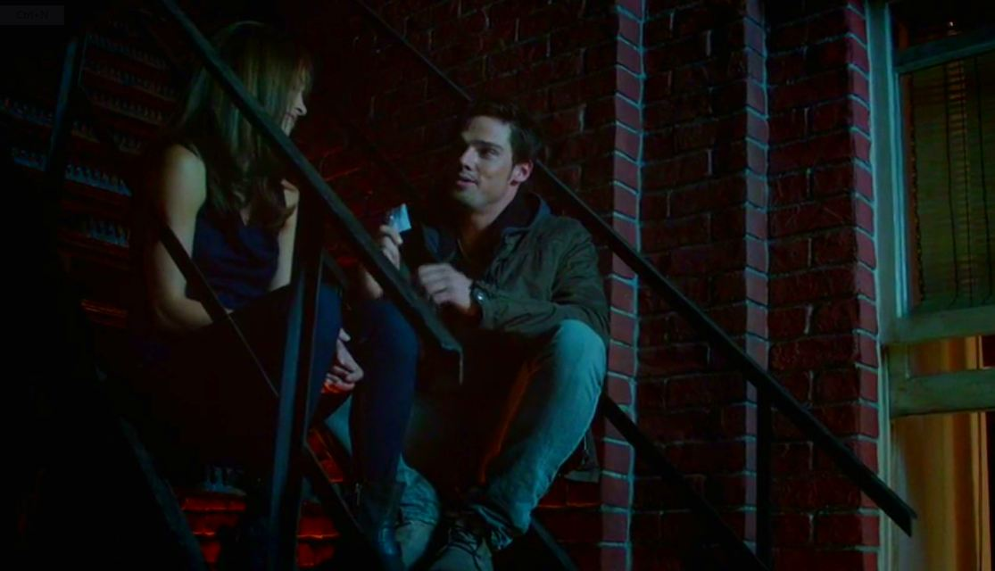
17) When Vincent gives Cat his phone number for the first time, how many days did he say it was valid for?

Slide 18
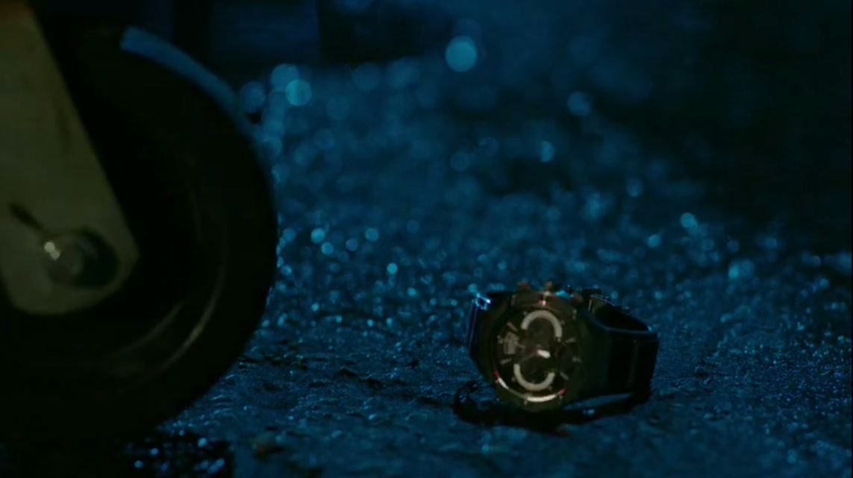
18) Whose watch did Vincent find in S01E04?

Slide 19
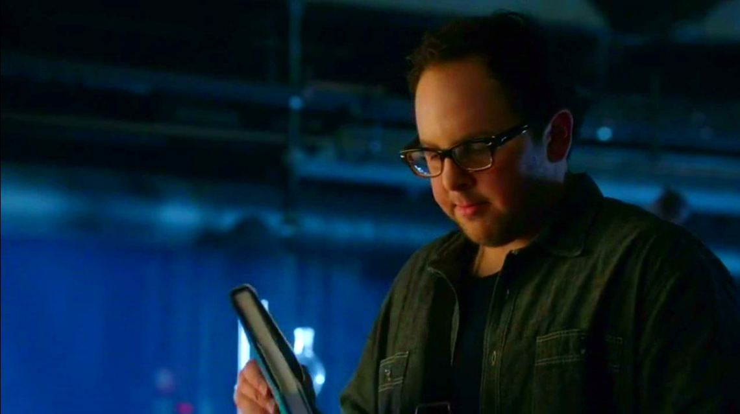
19) What did JT use to buy Vincent the book he wanted?

Slide 20
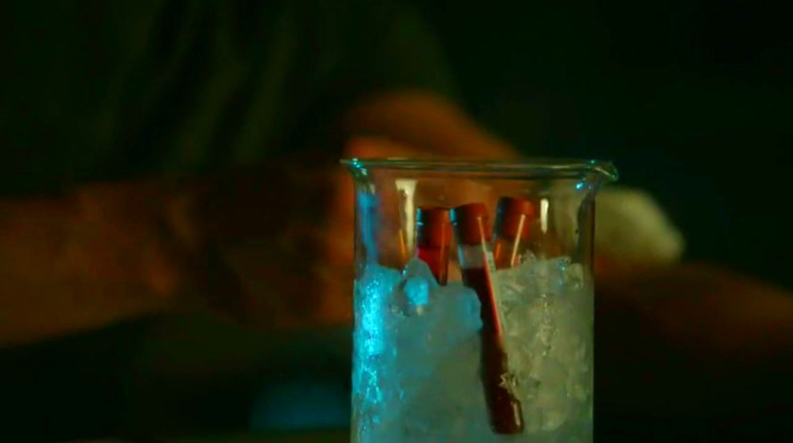
20) What did the note say that Vincent left with his blood?

Slide 21
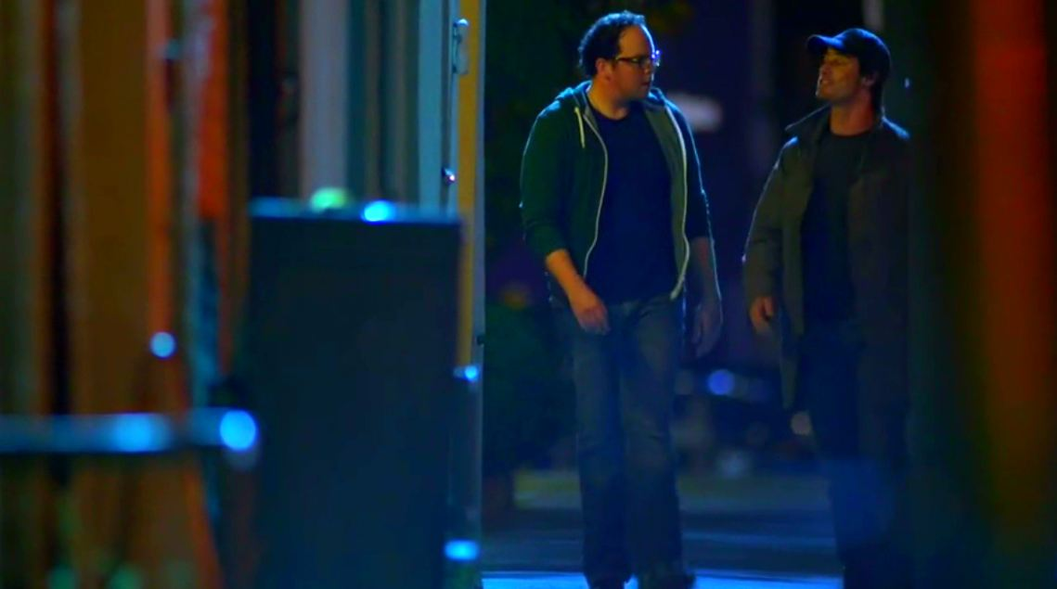
21) When JT & Vincent were out walking why did JT say to Vincent he wasn't asking Sara out?

Slide 22
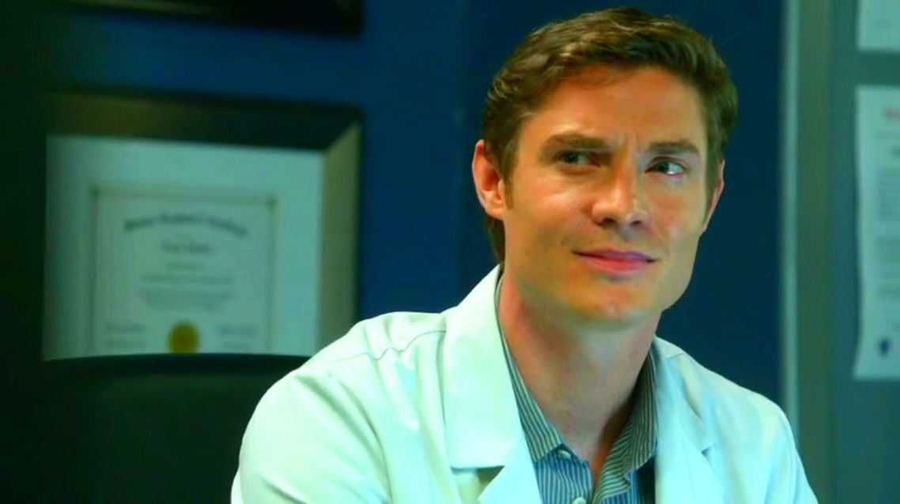
22) What did Heather ask Evan to bring to Cat's birthday party?

Slide 23
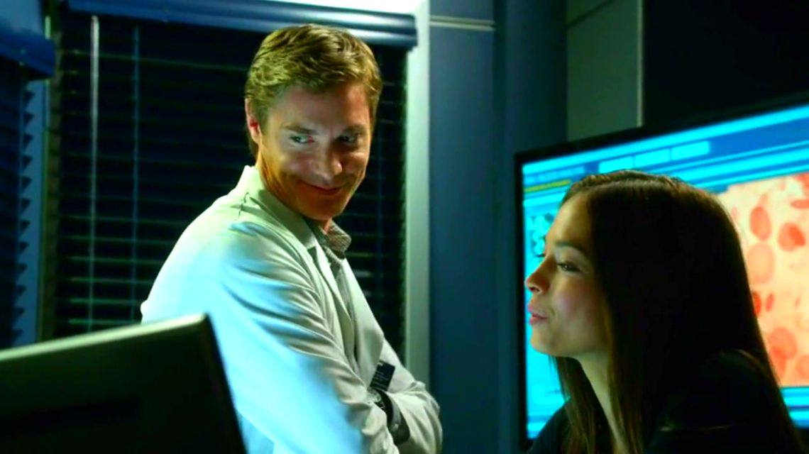
23) What is the name of the lady Evan met via his online dating site?

Slide 24
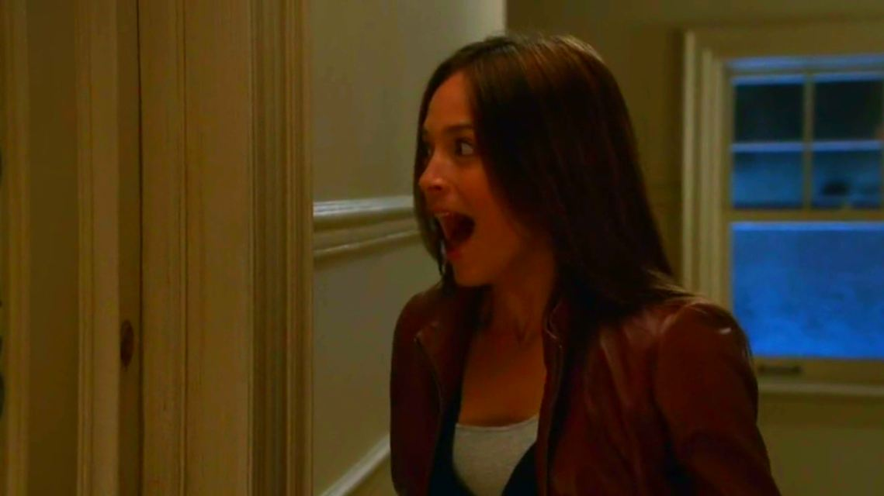
24) What apartment number does Cat live at?

Slide 25
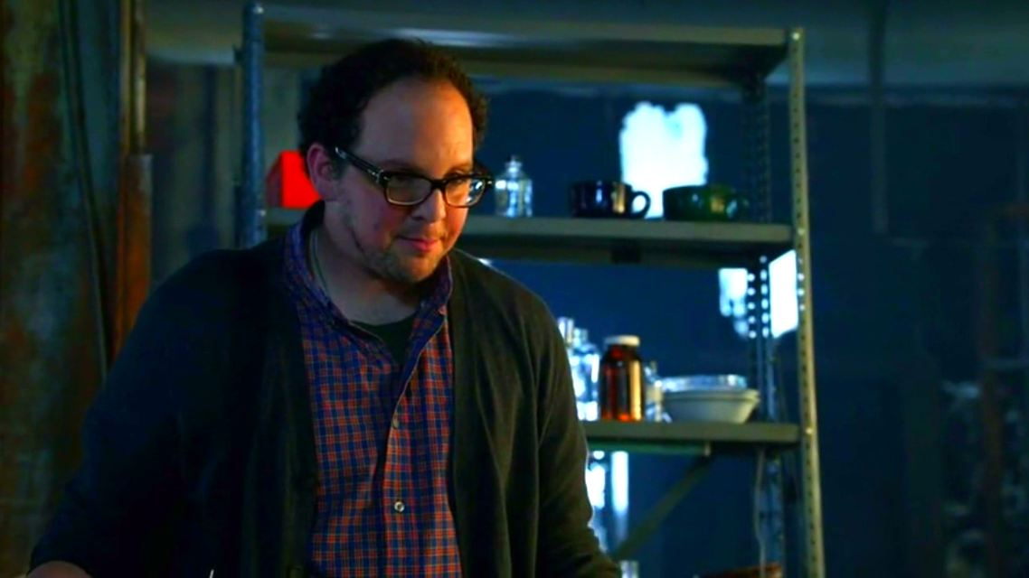
25) What club did JT say he was president of in S01E06?

Slide 26
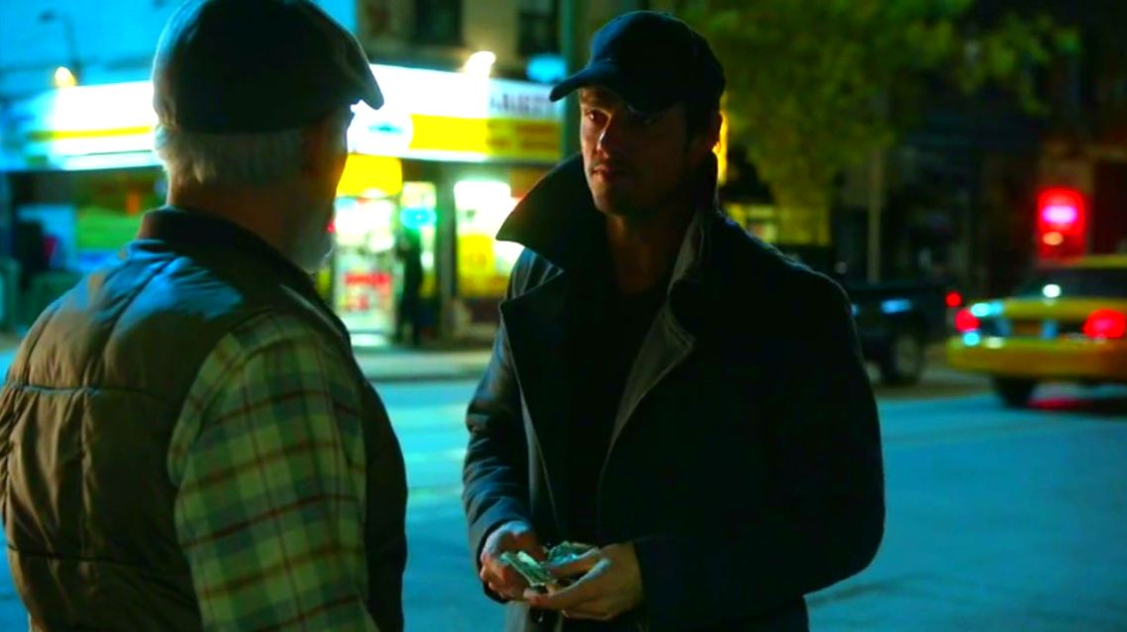
26) What did Vincent pay this man for a newspaper?

Slide 27
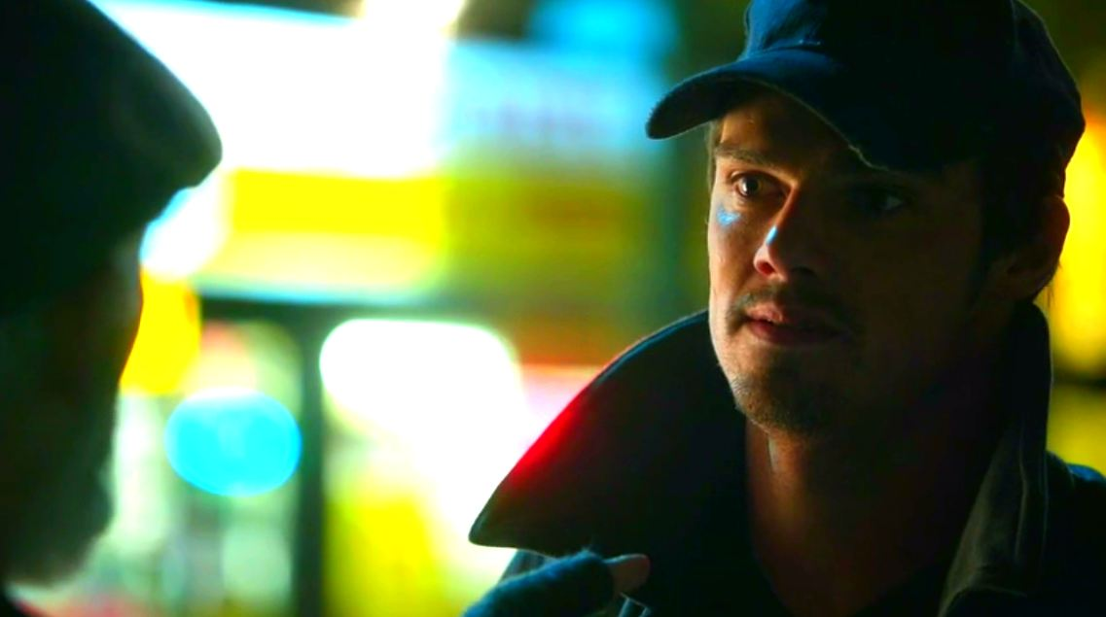
27) What was Vincent's dad's name?

Slide 28
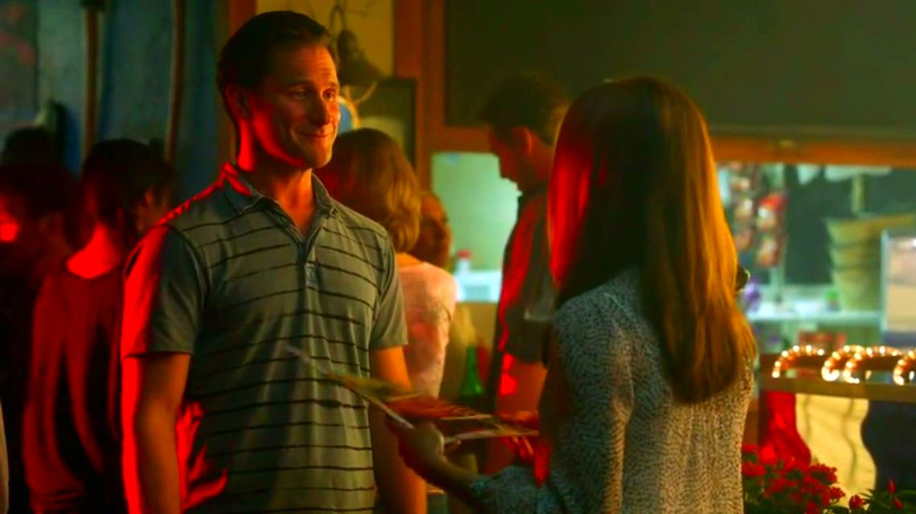
28) At the fire-fighters calendar launch party what month was Mike Strickland?

Slide 29
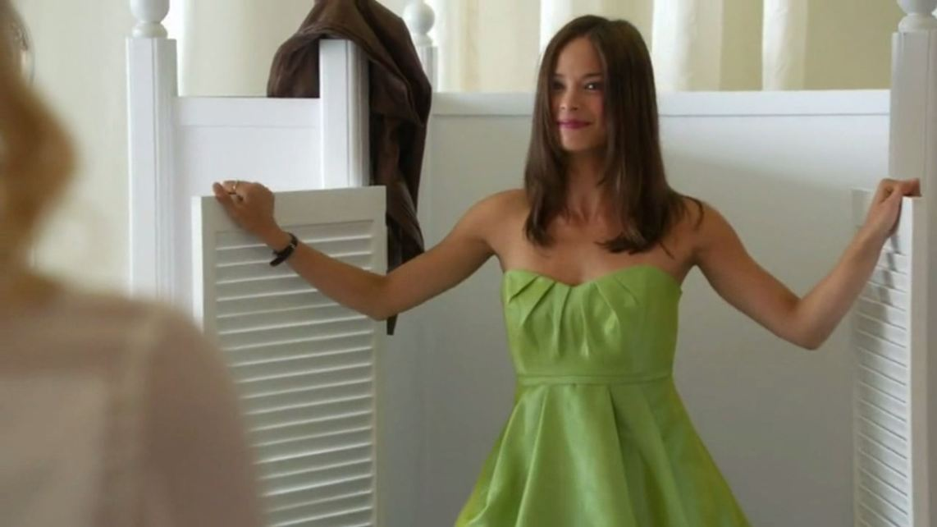
29) How did Brooke describe the green bridesmaid dress that Cat tried on?

Slide 30
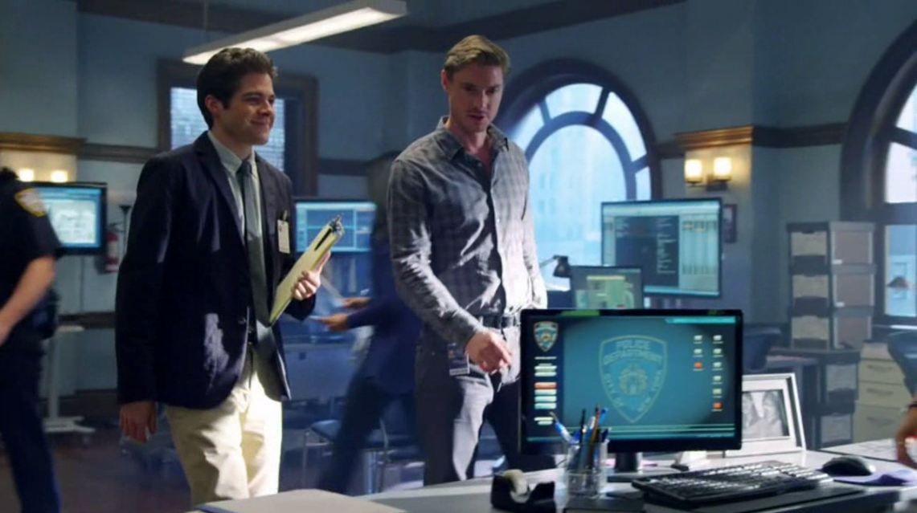
30) What was the name of Evan’s new intern who then attempted to kill him?

Slide 31
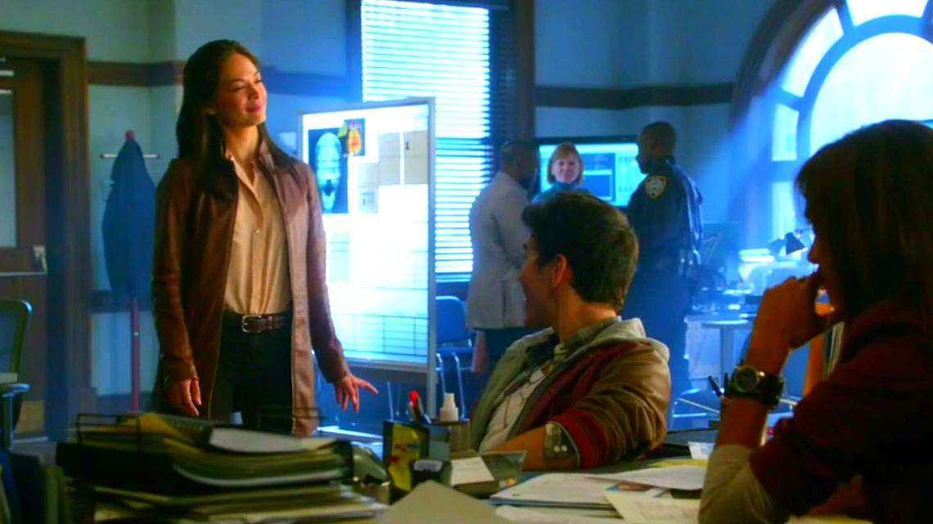
31) What nicknames did Jake Riley give Cat & Tess?

Slide 32
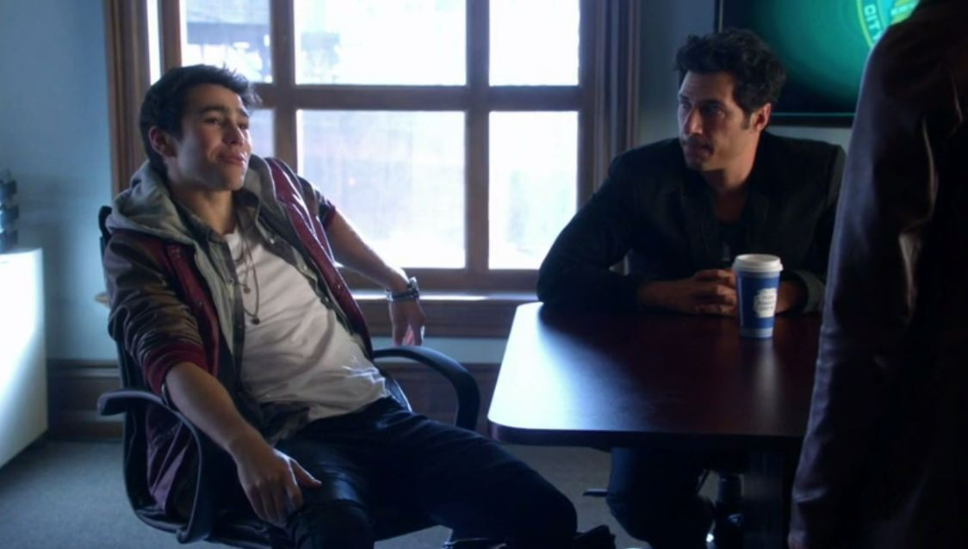
32) What is the name of Jake Riley's Manager?

Slide 33
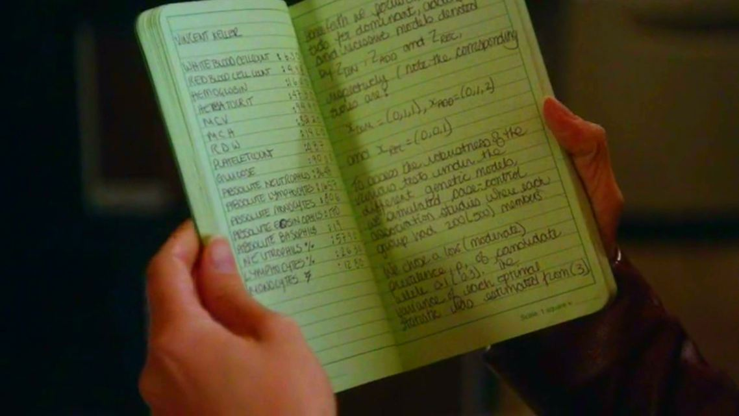
33) What colour notebook did JT say that Vincent saw Vanessa Chandler making notes in?

Slide 34
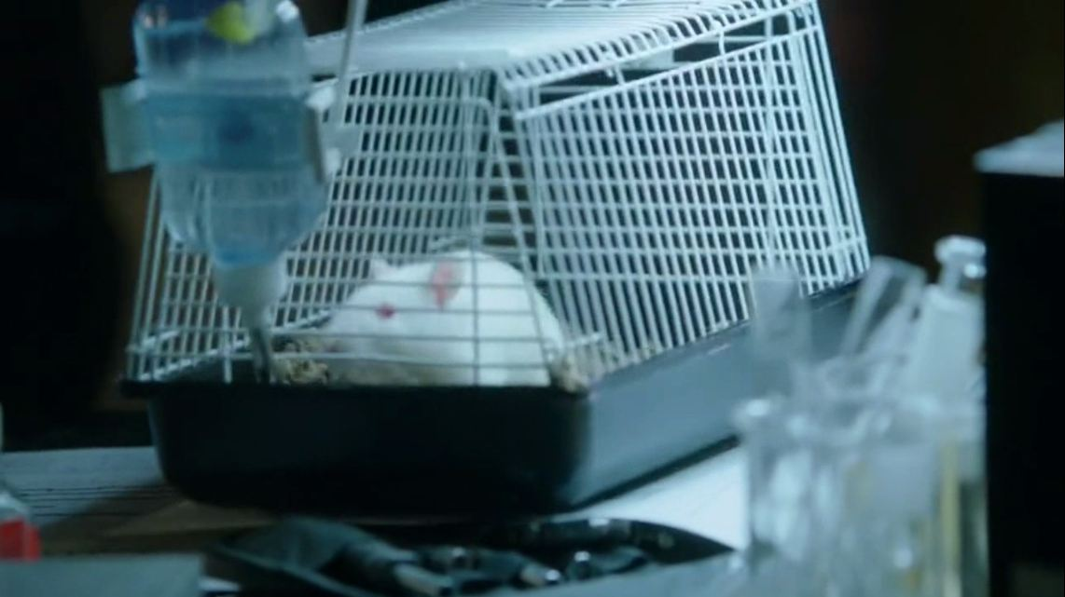
34) What is the name of the rat JT snagged from the university?

Slide 35
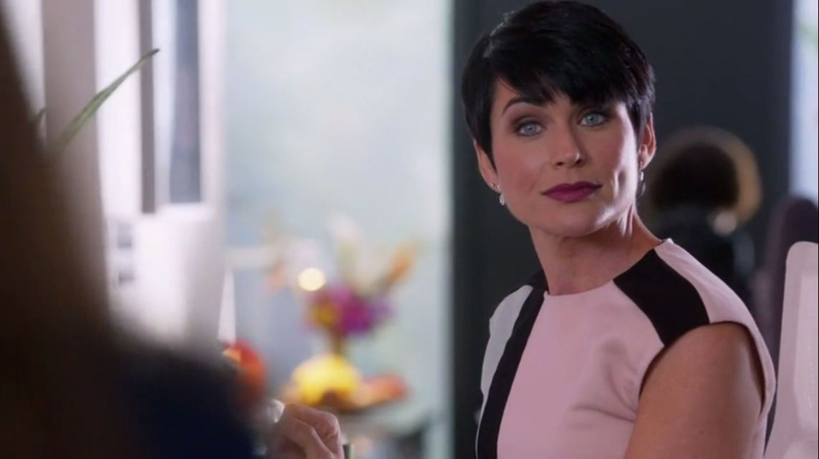
35) What is the name of this matchmaker?

Slide 36
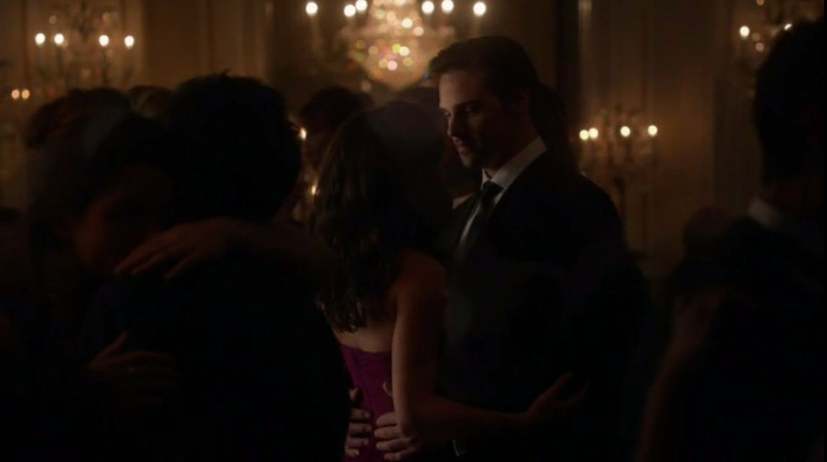
36) What song did Catherine & Vincent first dance to?

Slide 37
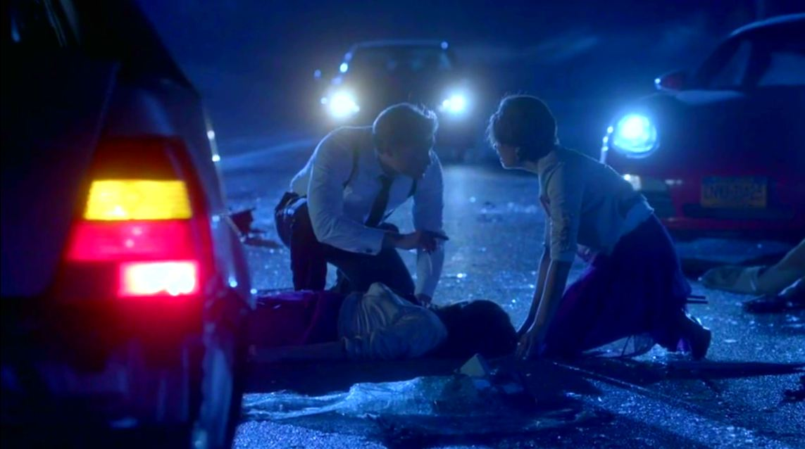
37) What did Evan tell Heather to get from the car when they found Cat lying on the road?

Slide 38
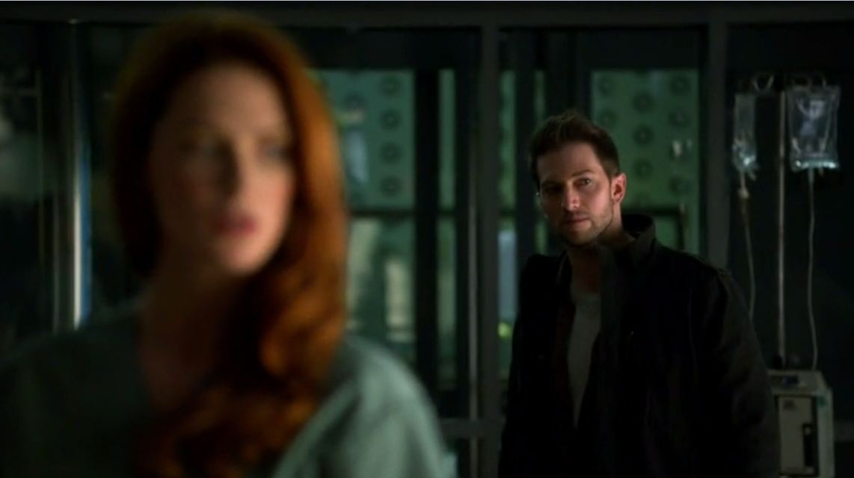
38) What is the name of this guy who was stalking Alex?

Slide 39
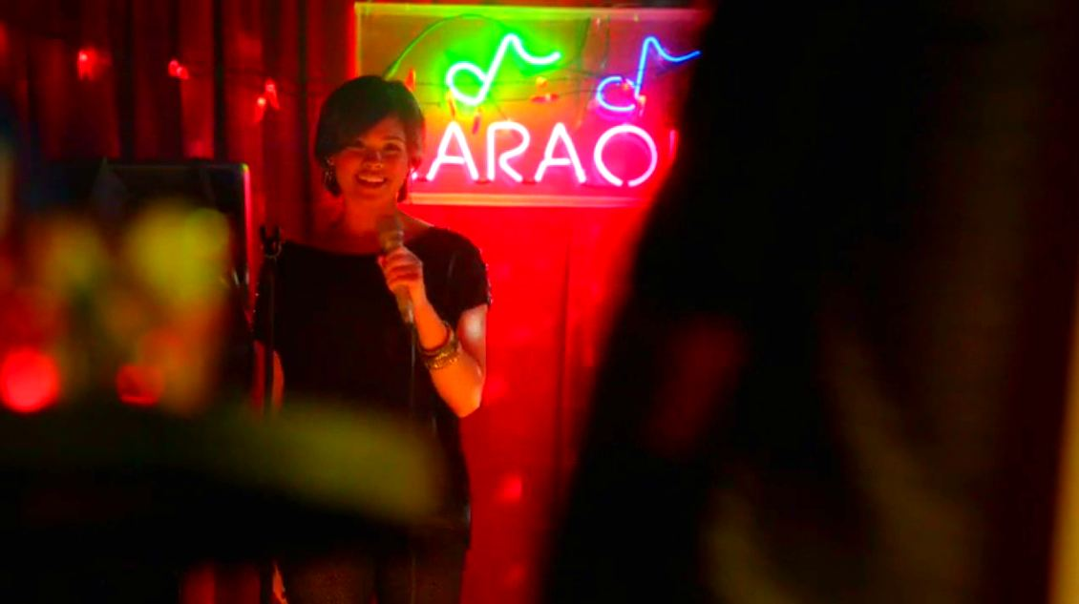
39) What song did Heather sing alone at Karaoke?

Slide 40
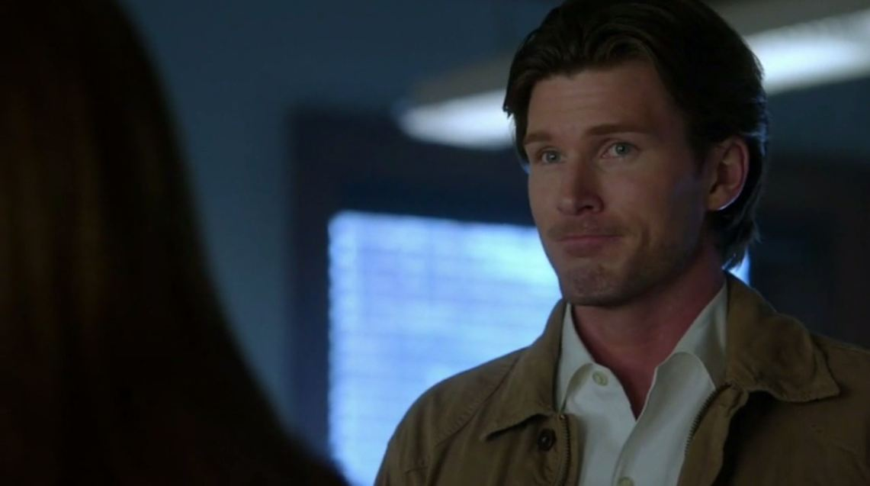
40) What is the name of this man?

Slide 41
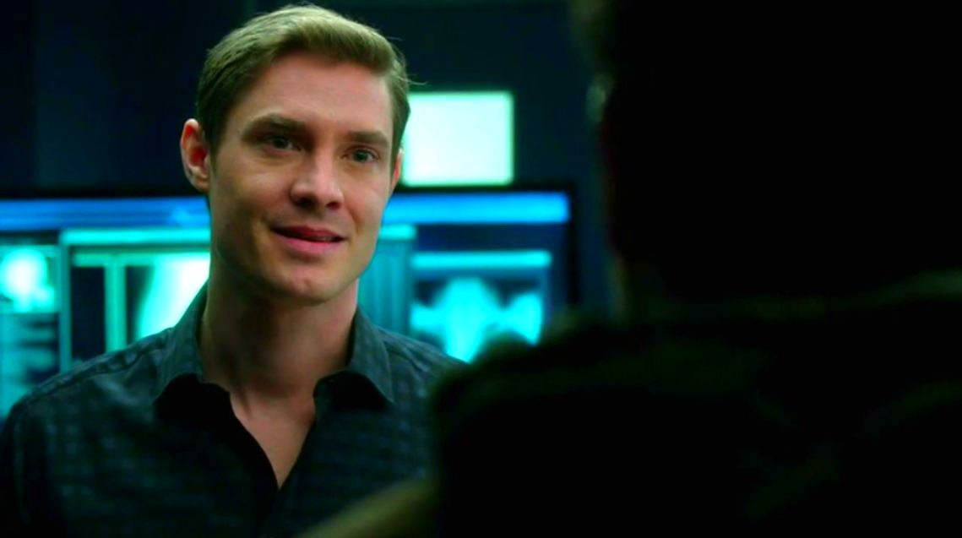
41) What is the name of the girl that died on Evan’s operating table back in the UK?

Slide 42
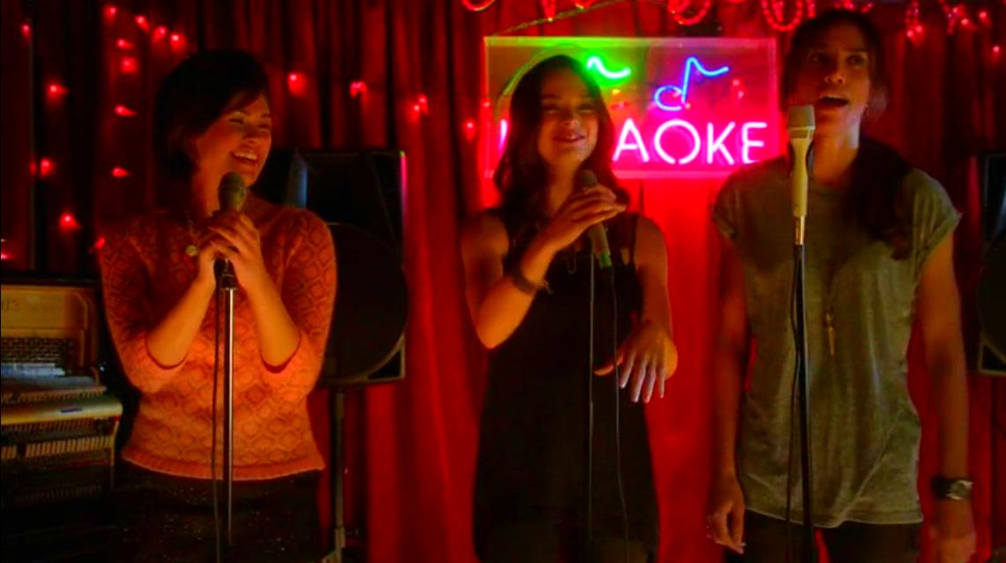
42) What song did Cat, Heather & Tess sing at Karaoke?

Slide 43
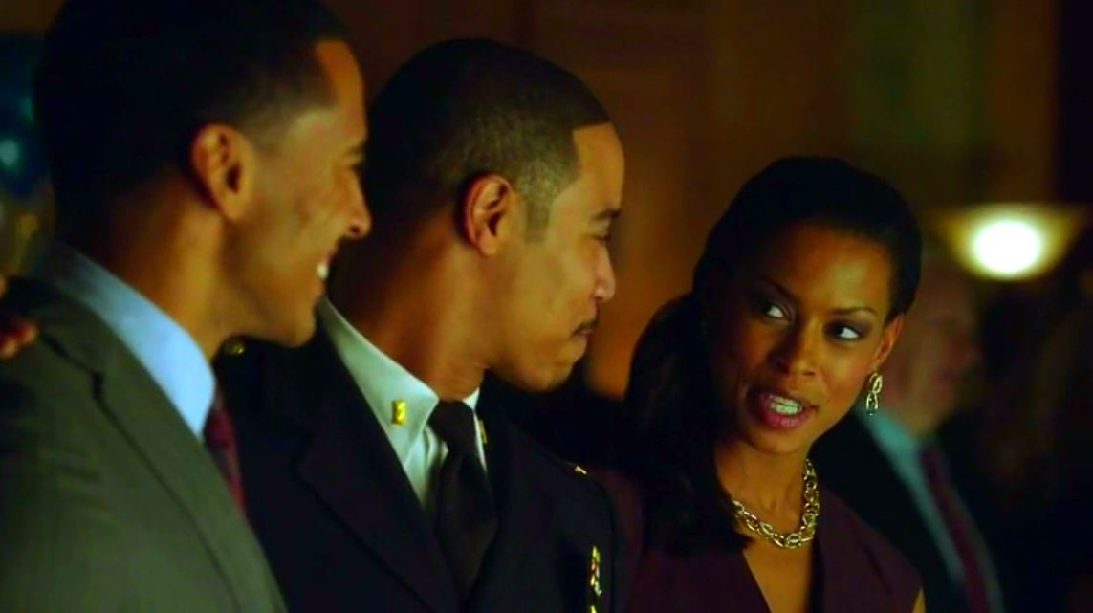
43) What is Joe Bishops wife called?

Slide 44
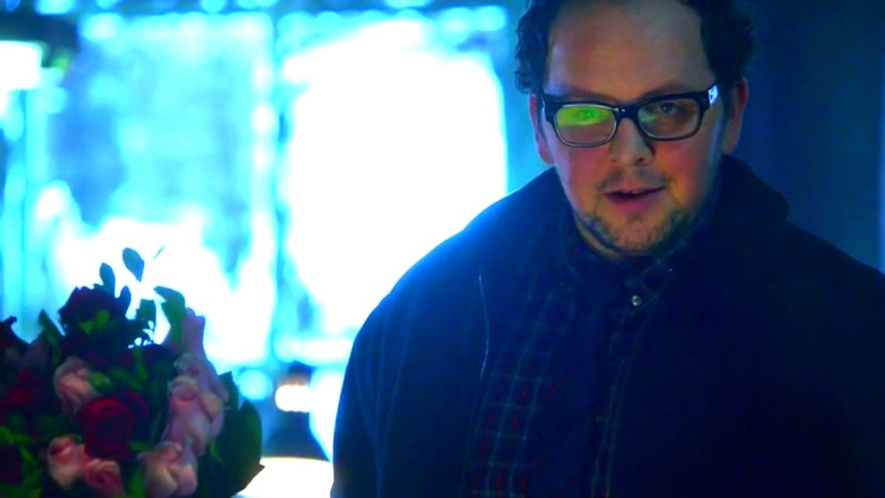
44) What did JT plan for Sara on Valentines day?

Slide 45
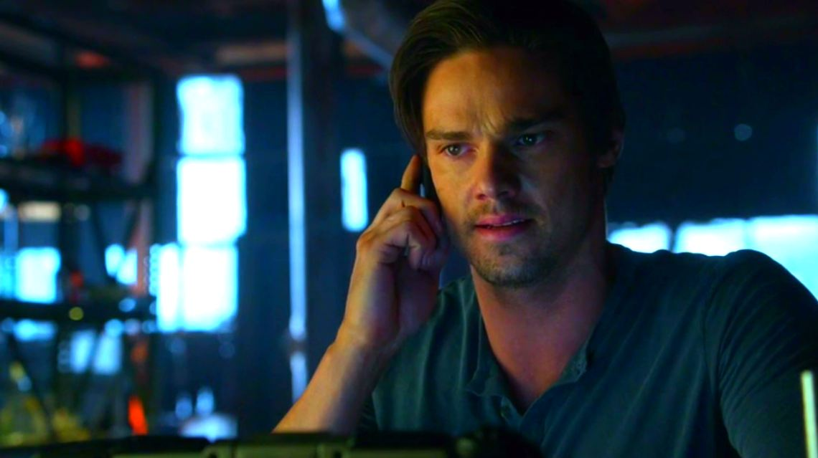
45) What hotel did Alex tell Vincent to come to?

Slide 46
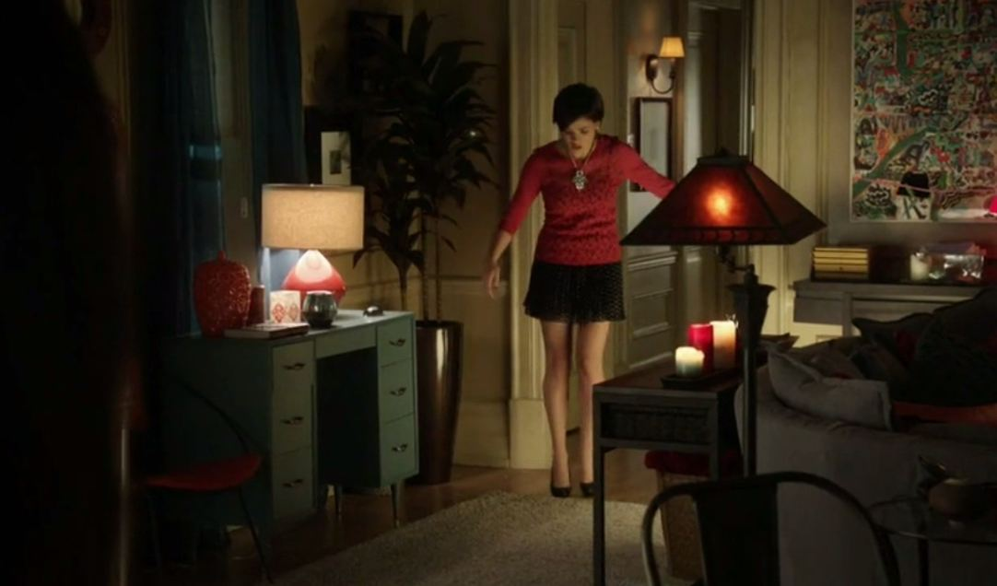
46) How did Heather describe this outfit?

Slide 47
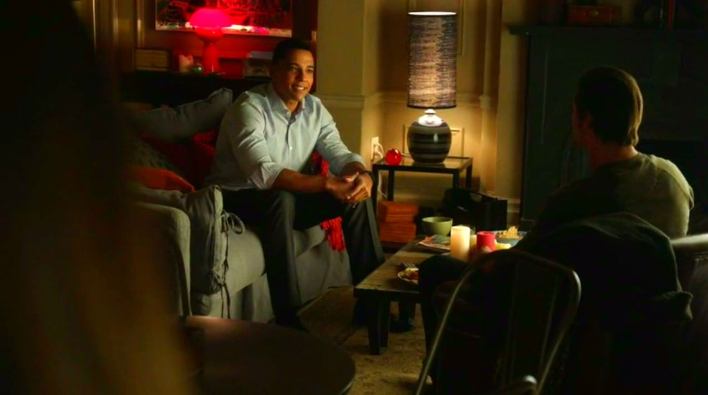
47) What clubs did Darius tell Vincent that he promotes?

Slide 48
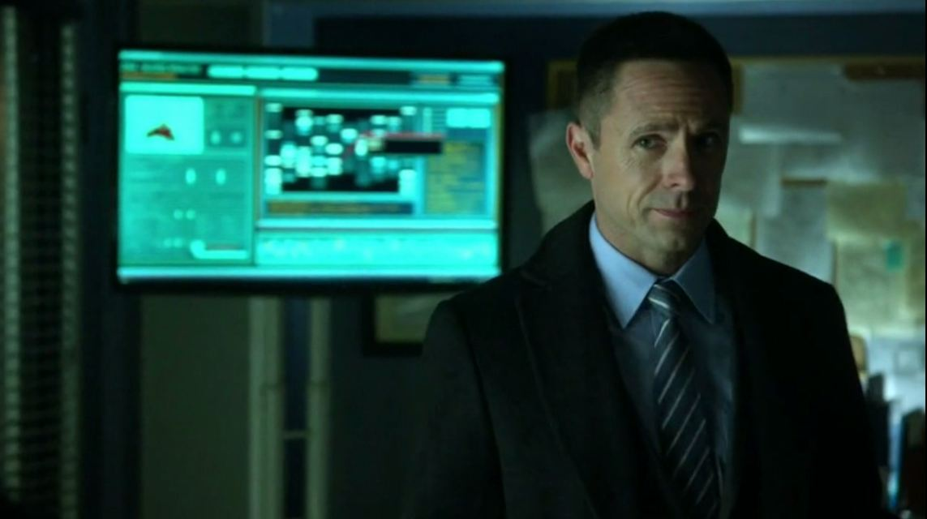
48) What is the name of this man?

Slide 49
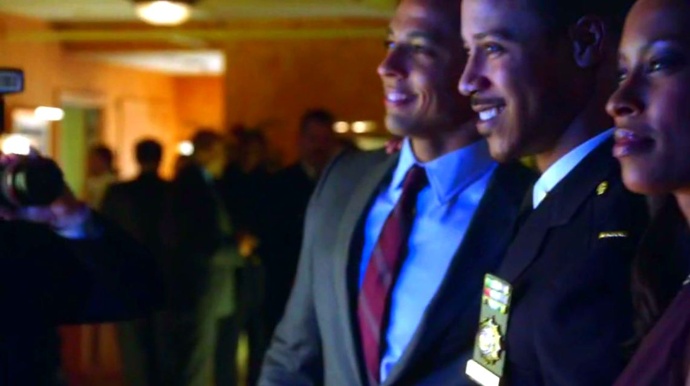
49) What colour dress did Cat wear to Joe Bishops Award Ceremony/Party?

Slide 50
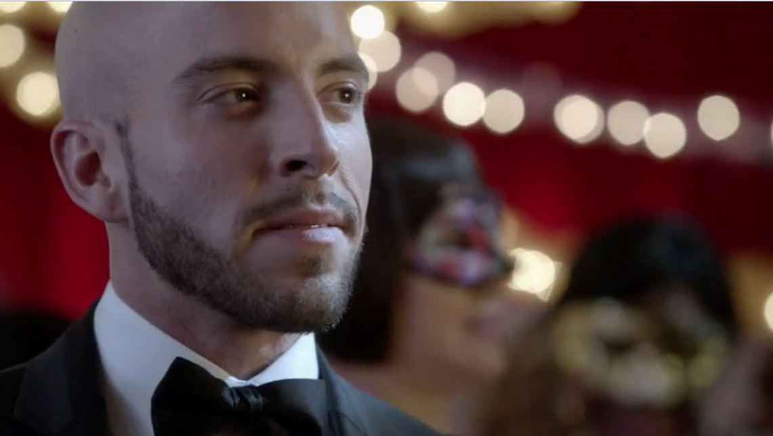
50) What is the name of this man?

Slide 51
51) What is Vincent’s middle name?

Slide 52
52) What is this medieval weapon called?

Slide 53
53) What is the name of this man?

Slide 54
54) What is the name of the new medical examiner?

Slide 55
55) Why did Cat's mom wear a necklace with a Chimera on it?

Slide 56
56) What flowers did Catherine take to her moms grave on the 10yr anniversary of her death?

Slide 57
57) What are Cat & Vincent called on their fake ID's?

Slide 58
58) Where is this swimming pool?

Slide 59
59) What is the name of this town that Cat & Vincent visited for the day?

Slide 60
60) What were the last 5 words spoken at the end of Season 1?

Slide 61
61) At the start of S2 what time was it when Cat called JT?

Slide 62
62) Where did Cat head off to when facial recognition got a hit on Vincent at the start of S2?

Slide 63
63) What are Vincent’s cufflinks made out of?

Slide 64
64) How many tranq darts did it take to stop Vincent?

Slide 65
65) How many years ago did JT tell Vincent this photo was taken?

Slide 66
66) What is the name of this geneticist?

Slide 67
67) What law firm did Thomas Chandler work for?

Slide 68
68) What did JT say that Vincent can now do to heighten specific senses?

Slide 69
69) What bridge did Vincent take to Rikers?

Slide 70
70) What was the name of the Doctor that Vincent pretended to be in S02E02?

Slide 71
71) What facts did Vincent say he remembered about the 90's?

Slide 72
72) What was Catherine’s password for her car GPS?

Slide 73
73) What is the name of this girl that Vincent arranged to meet at a club?

Slide 74
74) What is this Agents name?

Slide 75
75) What new job did Heather land in Miami?

Slide 76
76) Why was this painting called "Friday at Five"?

Slide 77
77) A painting by which artist did Cat tell Nigel Clifton she had spilt red wine on?

Slide 78
78) What 3 things did Vincent tell Catherine he had remembered at the end of S02E03?

Slide 79
79) What is the name of this pyromaniac?

Slide 80
80) What does Aaron call Cat & Vincent when they visit him at the fire station?

Slide 81
81) What are the names of Vincent’s two brothers?

Slide 82
82) What is the name of Vincent's army buddy?

Slide 83
83) What is the name of this journalist?

Slide 84
84) What time each night did Tori turn off the alarm to go out on the Balcony?

Slide 85
85) What is the name of this place that Vincent took Tori to lure her dad?

Slide 86
86) Where is Bob Reynolds house?

Slide 87
87) What "code word" did Cat & Vincent use when they visited Bob Reynolds house to see if he was lying?

Slide 88
88) Where is this? (Building Name, Number & Street)

Slide 89
89) What is the name of this lady that Cat impersonates for the FBI?

Slide 90
90) What sign did Cat to give to this man with a gothic neck tattoo?

Slide 91
91) What is this mans name?

Slide 92
92) What was the theme of the "celebrity cooking class" that Cat hosted?

Slide 93
93) What grant did JT believe he had won?

Slide 94
94) What was the name of Dana & Sam Landon’s son?

Slide 95
95) Where were Sam & Dana going to renew their wedding vows?

Slide 96
96) Who did JT say that Cat & Vincent look like here?

Slide 97
97) What is the name of this doctor?

Slide 98
98) What is the name of this man?

Slide 99
99) What is the name of this man?

Slide 100
100) When Cat asked Vincent & Gabe to pick a number between 1 & 10 - what did they choose?

Slide 101
101) Who are Cat & Gabe pretending to be at this event?

Slide 102
102) What police station did they take Vincent to?

Slide 103
103) What photos did Gabe show cat in relation to Vincent’s arrest?

Slide 104
104) What is the name of the lawyer Gabe arranged for Cat?

Slide 105
105) What song did Vincent play for their bathtub dance?

Slide 106
106) What is the name of the ex-con that Gabe said Bob Reynolds had paid money to?

Slide 107
107) What is the name of this FBI Special Agent?

Slide 108
108) What is the name of the FBI agent that Cat & Vincent rescued?

Slide 109
109) What is the name of Heathers Fiancé?

Slide 110
110) Who kidnapped Heather?

Slide 111
111) What is Cat's challenge question on the "Find Your Phone" App?

Slide 112
112) What is the name of this witness?

Slide 113
113) What names are Cat & Vincent given in witness protection?

Slide 114
114) What is the number & street name of their witness protection house?

Slide 115
115) What are the names of this couple?

Slide 116
116) Where are Tess & JT Shopping?

Slide 117
117) What is the name of this Stripper?

Slide 118
118) What did Vincent say was wrong with Gabe?

Slide 119
119) Where was Gabe sitting & waiting for Vincent to find him?

Slide 120
120) What did the government agents do to save JT?

